Slide 1

Java and TDD Coding Dojo (Session 2)

Slide 2
Agenda
Java Packages
Java access modifiers
Nonaccess modifiers
Features and components of java

Slide 3
Coding Dojo Rules
- Respect
- No one know more than other. We all are equal
- Help your peer
- Be cool
- Repeat until you know and do it fast…..

Slide 4
Java Packages
Why do you think we need packages?
- You can use a package to group together a related set of classes, interfaces, and others Java components.
- Java packages also provide access protection and namespace management.
- You can create separate packages to define classes for separate projects, such as Android games and online healthcare systems.
- Further, you can create subpackages within these packages, such
as separate subpackages for GUIs, database access, networking, and so on.
- All classes and interfaces are defined in a package. If you don’t include an explicit package statement in a class or an interface, it’s part of a default package.

Slide 5
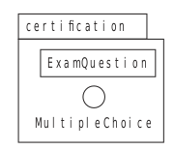

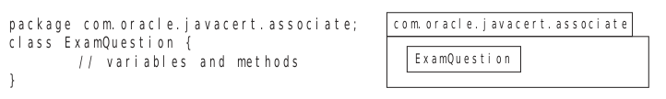
Defining classes in a package using the package statement

Slide 6
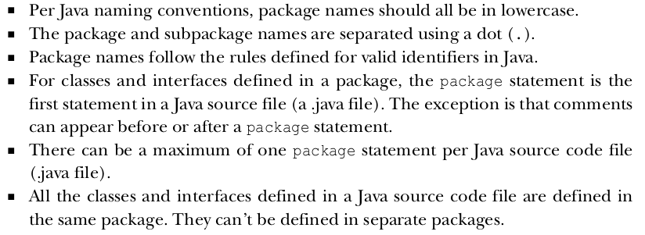
RULES TO REMEMBER
NOTE: when we talk about fully qualified name for a class or interface is the name formed by prefixing its package name with its name (separated by a dot) . E.g. com.oracle.javacert.associate.ExamQuestion

Slide 7
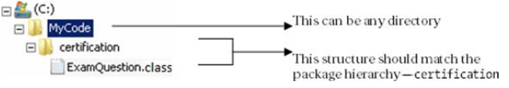
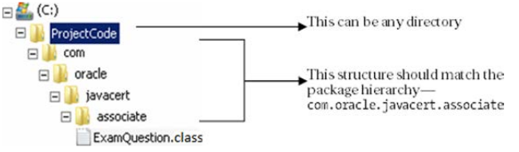
D IRECTORY STRUCTURE AND PACKAGE HIERARCHY

Slide 8

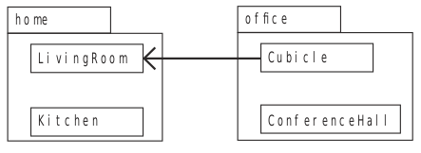
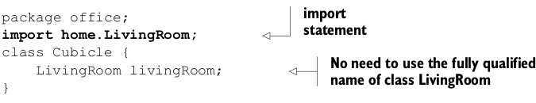
Using simple names with import statements
The import statement enables you to use simple names instead of using fully qualified
names for classes and interfaces defined in separate packages.
NOTE The import statement doesn’t embed the contents of the imported class in your class, which means that importing more classes doesn’t increase the size of your own class.

Slide 9
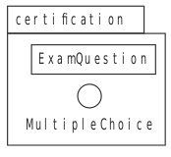

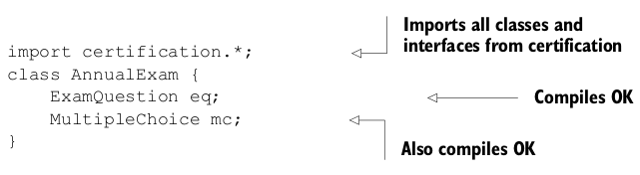
Importing a single member versus all members of a package

Slide 10
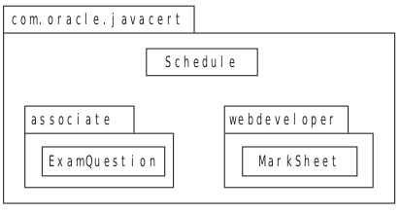
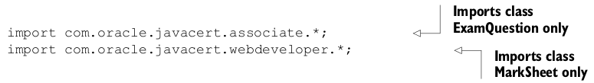
The import statement doesn’t import the whole package tree
You can’t import classes from a subpackage by using an asterisk in the import statement.

Slide 11

Importing classes from the default package
- A class from a default package can’t be used in any named packaged class, regardless of whether they’re defined within the same directory or not.
- Members of a named package can’t access classes and interfaces defined in the default package.

Slide 12
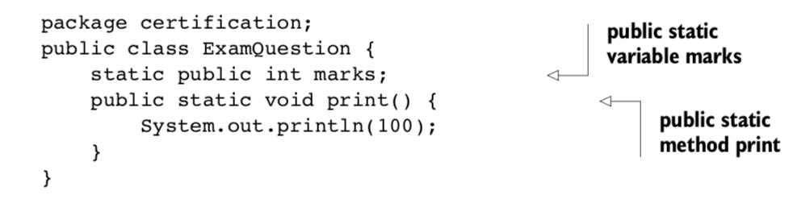


Static imports
You can import an individual static member of a class or all its static members by using the import static statement.
NOTE On real projects, avoid overusing static imports; otherwise, the code might become a bit confusing about which imported component comes from which class.

Slide 13
Java Access Modifiers
WHAT DO THEY CONTROL ?
Access modifiers control the accessibility of a class or an interface, including its members (methods and variables), by other classes and interfaces within the same or separate packages. By using the appropriate access modifiers, you can limit access to your class or interface and their members.
CAN ACCESS MODIFIERS BE APPLIED TO ALL TYPES OF J AVA ENTITIES ?
- Access modifiers can be applied to classes, interfaces, and their members (instance and
class variables and methods)
- Local variables and method parameters can’t be defined using access modifiers. An attempt to do so will prevent the code from compiling.

Slide 14
Java Access Modifiers
HOW MANY ACCESS MODIFIERS ARE THERE : THREE OR FOUR ?
- public (least restrictive)
- protected
- private
- default access (most restrictive)
NOTE: If a Java class, interface, method, or variable isn’t defined using an explicit access modifier, it is said to be defined using the default access, also called package access.

Slide 15
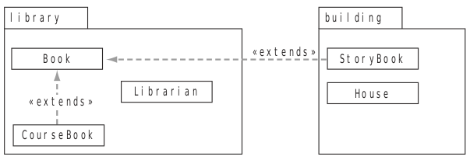
Java Access Modifiers

Slide 16
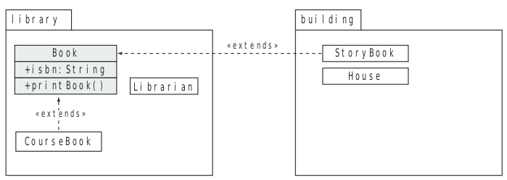
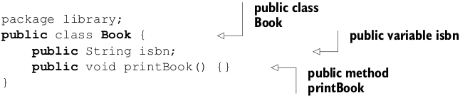
Java Access Modifiers
public
Classes and interfaces defined using the public access modifier are accessible across all packages, from derived to unrelated classes.

Slide 17
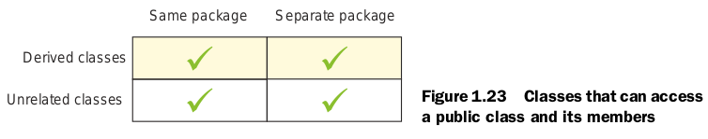
Java Access Modifiers
public

Slide 18
Java Access Modifiers
protected
The members of a class defined using the protected access modifier are accessible to
- Classes and interfaces defined in the same package
- All derived classes, even if they’re defined in separate packages

Slide 19
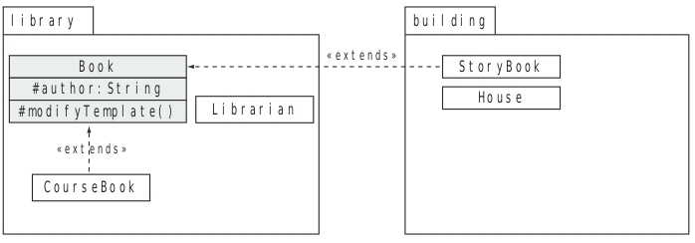
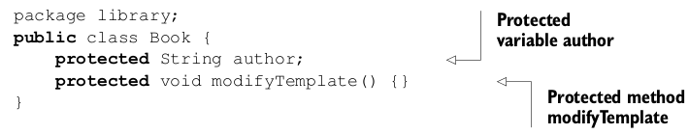
Java Access Modifiers
protected
Class House fails compilation for trying to access the method modifyTemplate and the variable author .

Slide 20
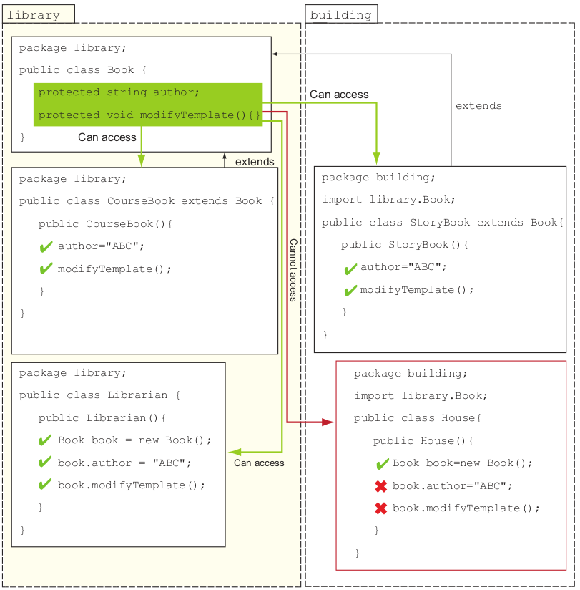
protected

Slide 21
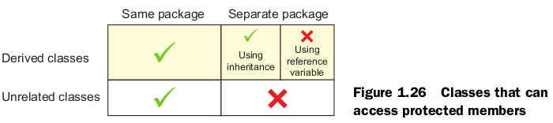
Java Access Modifiers
protected

Slide 22
Java Access Modifiers
Default access (package-private)
The members of a class defined without using any explicit access modifier are defined
with package accessibility (also called default accessibility). The members with package access are only accessible to classes and interfaces defined in the same package.

Slide 23
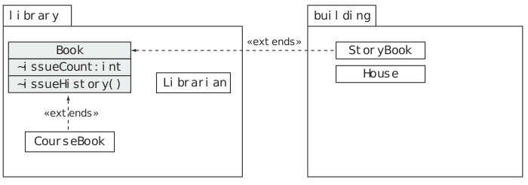
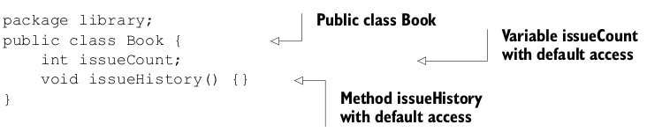
Java Access Modifiers
Default access (package-private)

Slide 24
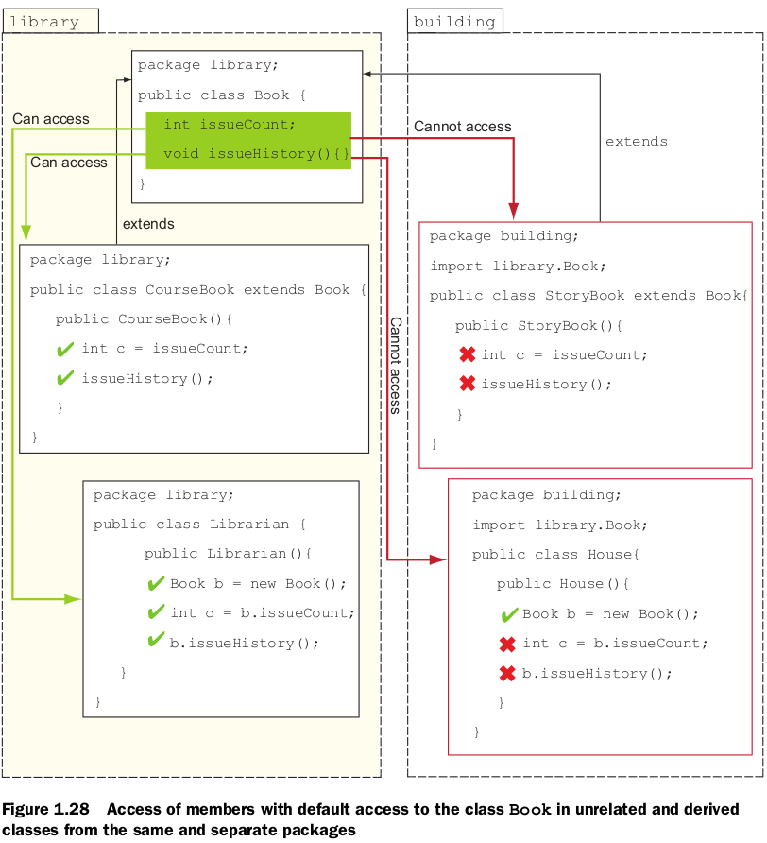
Default access (package-private)

Slide 25
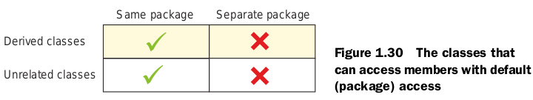
Java Access Modifiers
Default access (package-private)

Slide 26
Java Access Modifiers
private
The private access modifier is the most restrictive access modifier. The members of a
class defined using the private access modifier are accessible only to themselves.

Slide 27
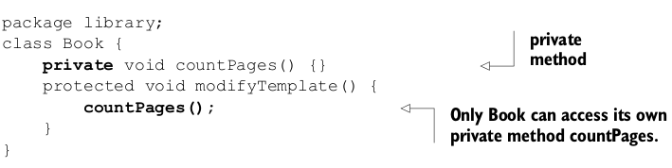
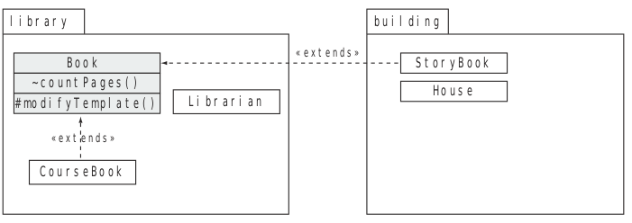

Java Access Modifiers
private

Slide 28
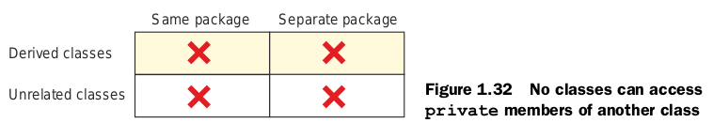
Java Access Modifiers
private

Slide 29
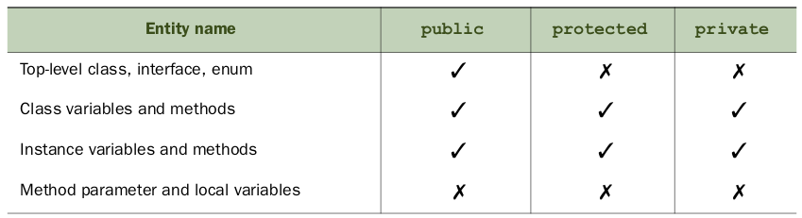
Access modifiers and Java entities

